Slide 1
Employee Data Analysis using Excel
STUDENT NAME: P. keerthivarman
REGISTER NO: 312203776 / 875422B0896A298ECE48178D5FD4446
DEPARTMENT: DEPARTMENT OF COMMERCE
COLLEGE: HINDUSTAN COLLEGE OF ARTS & SCIENCE

Slide 2
PROJECT TITLE
Employee Performance Analysis using Excel

Slide 3


AGENDA
Problem Statement
Project Overview
End Users
Our Solution and Proposition
Dataset Description
Modelling Approach
Results and Discussion
Conclusion
3/21/2024 Annual Review

Slide 4

PROBLEM STATEMENT
This PowerPoint is about the performance analysis of the employees in a company during a particular period.
The performance analysis is use to know about the work of an employee.
By doing this we can easily identify the best employees of the company.

Slide 5

PROJECT OVERVIEW
Employee performance analysis is the process of evaluating how well employees perform their job duties and responsibilities. This involves assessing various aspects of their work, including productivity, quality, and efficiency, as well as their contribution to organizational goals.
In this project the performance is analyzed by using the employee’s gender, business unit, performance category, first name, last name, date of birth, performance rating and with 20 more columns.

Slide 6


WHO ARE THE END USERS?
The end users of the employee performance analysis are:
Employee
Employer
Manager
Supervisors
HR
Executives
Senior leadership
Financial analyst
Training and development teams

Slide 7

OUR SOLUTION AND ITS VALUE PROPOSITION
USED FORMULAS AND TECHNIQUES:
Conditional formatting to find the blank cells.
Filter option to eliminate the blank cells in the columns.
IFS formula to convert the performance rating to text.
Pivot table to make a summary about the project.
Chart visualization for easy understanding of the analysis.

Slide 8
Dataset Description
DETAILS OF THE DATASET:
Downloaded the dataset from the Edunet student dashboard.
It contains totally 26 features.
In this project I have selected 9 features to analyse the performance.
Employee ID and the current employee rating are in numerical values.
I have added one more feature called performance category to convert the rating into text by formula.

Slide 9

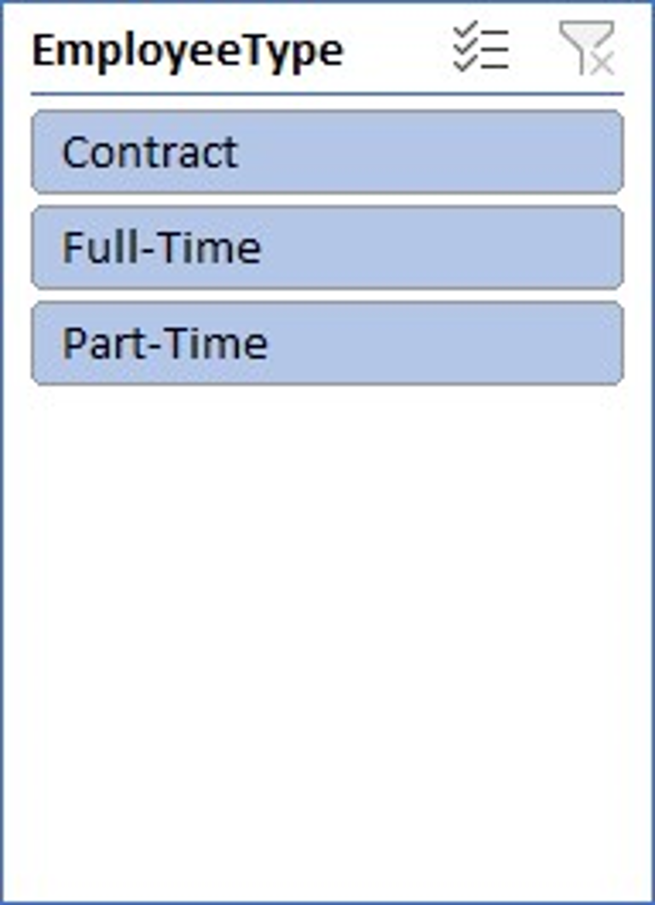
THE "WOW" IN OUR SOLUTION
The main thing of the project is converting the rating into text by using IFS formula:
=IFS(Z8>=5,"EXCELLENT",Z8>=4,"VERY GOOD",Z8>=3,"GOOD",TRUE,"LOW")
The second part is about the Pivot table used in the excel to easily identify the performance based on the employee work type:
3/21/2024 Annual Review
9

Slide 10
MODELLING
Data collection:
The employee dataset is collected from the Edunet dashboard.
Features collection:
Then, the features for the project is selected from the dataset.
Conversion:
Then, the rating is converted into text by using formula.
Creation of Pivot table:
Then, created a pivot table using the insert tool.
Where,
The business unit is used in the rows.
The gender code is used as filter.
The performance category is used as the values.
The employee classification type is used in columns.
Creation of chart:
The chart is created by using the insert tool.
Where,
Number of employees are in the Y axis and the business unit in the X axis. The chart is used to classify the male and female employees performances separately.
10

Slide 11
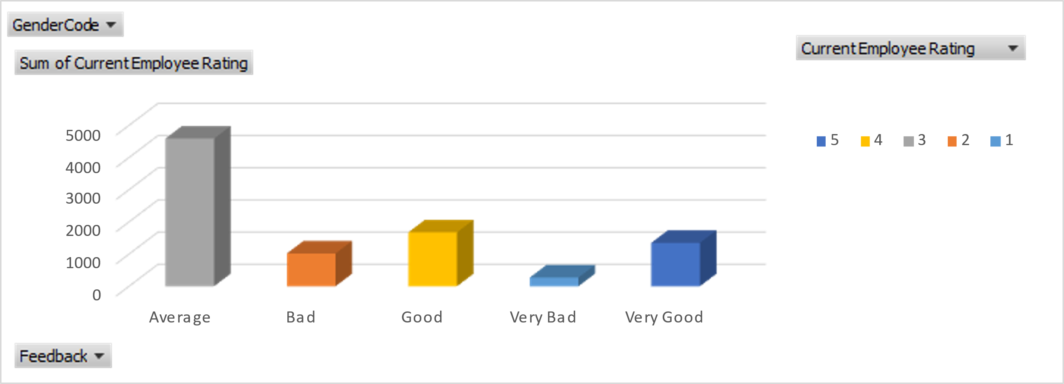
RESULTS
Chart for Female Employee performance analysis:
11

Slide 12
Conclusion
The conclusion of female employee analysis is that the temporary type employees are performing more than the other employees.
It shows that the number of employees in the full time job is between 18 and 36.
The number of employees in the part time job is between 19 and 38.
Lastly the number of employees in the temporary job is 23 and 40.
Therefore, the company may prefer temporary job persons more than others to get a good outcome.

